Slide 1


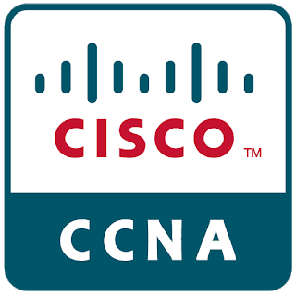
CCNA
NAME- DIWANSHU CHANDRA REGISTRATION – 11808583
SCHOOL OF COMPUTER APPLICATIONS BCA(HONS)

Slide 2
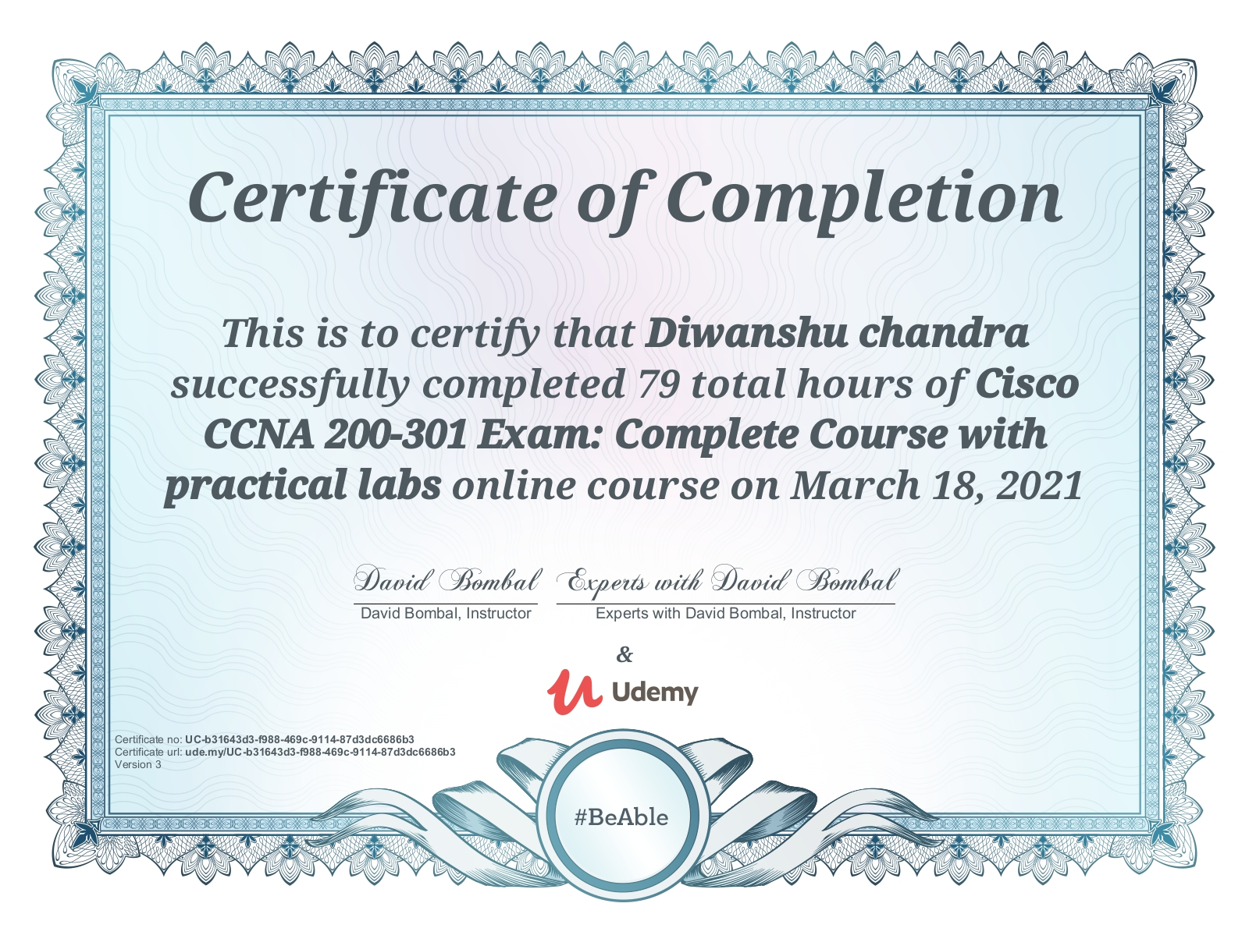
CERTIFICATE

Slide 3

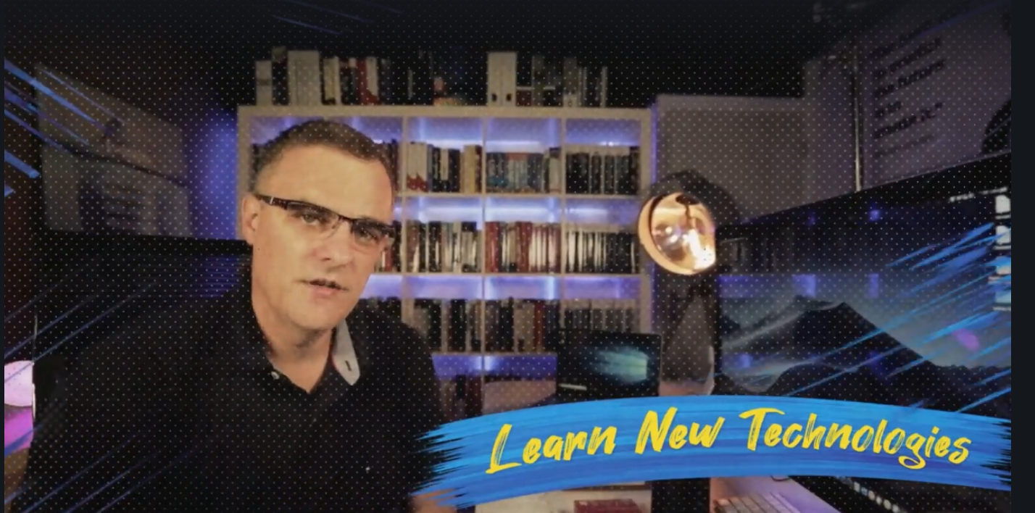
COURSE INSTRUCTOR

Slide 4
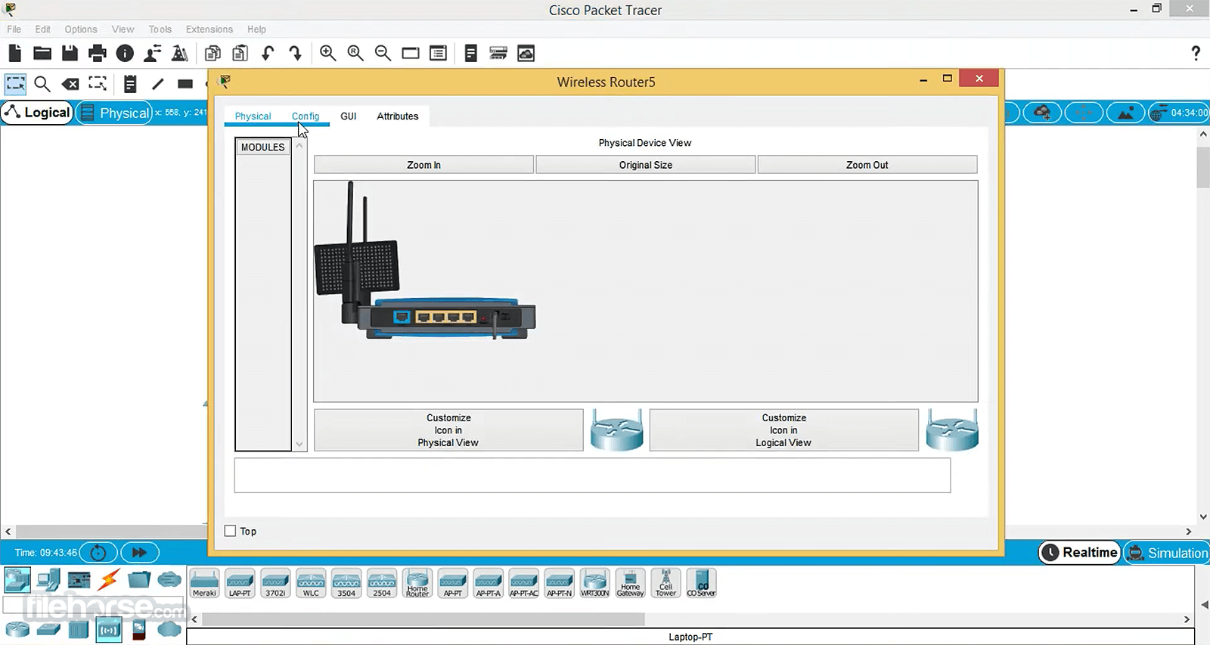

INSTALLATION OF RECOMMENDED SOFTWARE
Packet Tracer: Windows Installation

Slide 5
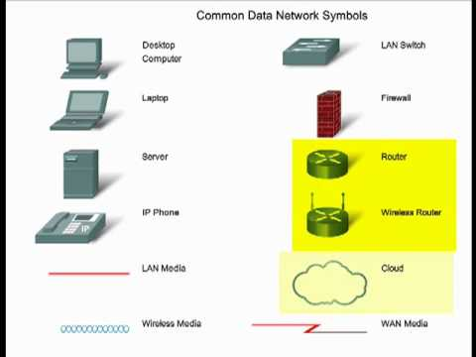
BASICS OF NETWORKING TERMS
Networking ?
Server
Clients
Ports and Protocols
Repeaters
HUBS
Switches and Routers
Firewalls
IDS and IPS
PORTS

Slide 6
OSI AND TCP/IP Model

Slide 7
TCP/IP Model

Slide 8
TCP/IP Model

Slide 9
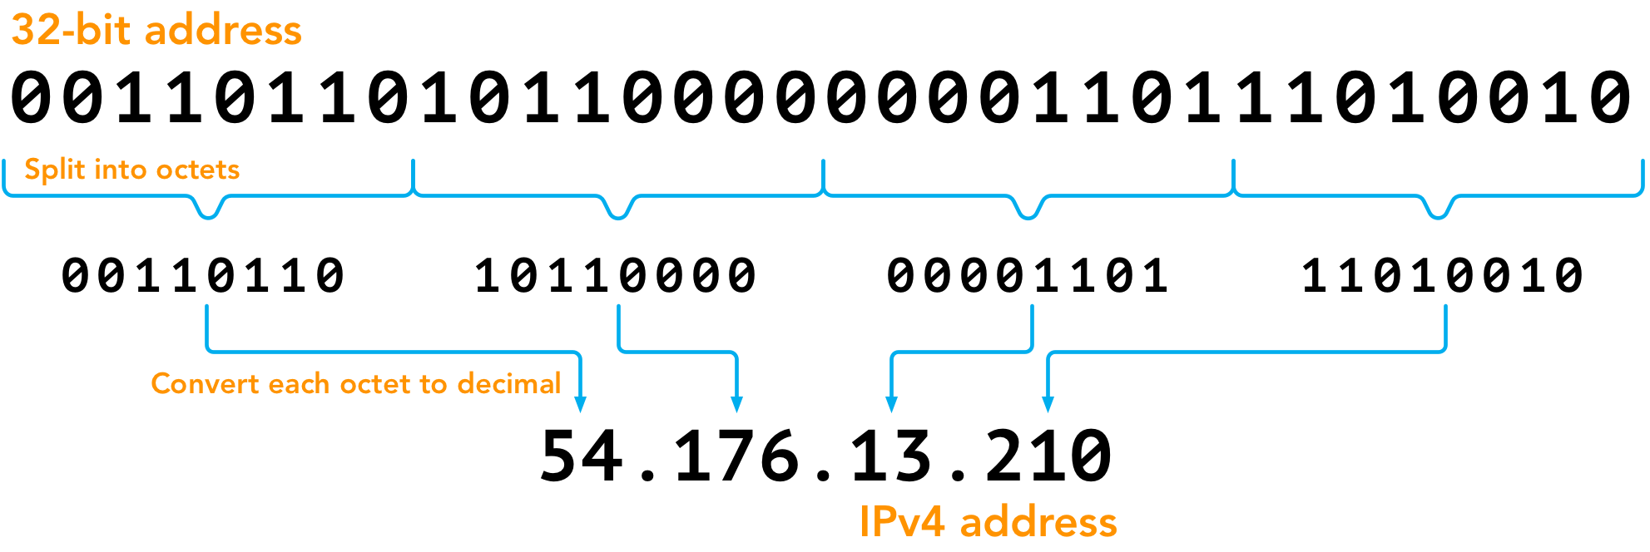
BINARY
BINARY MATHS (BASE-2)
HEXADECIMAL (BASE-16)
OCTALS (BASE-8

Slide 10
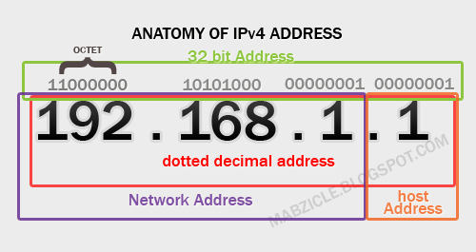
IP ADDRESSING
Layer 3 Logical Address assignment
Classed
Used to Identify Specific Devices
Local loopback and broadcast address
Every device on the Internet has Unique IP address
CIDR
Private and Public IP address
Subnet Mask

Slide 11
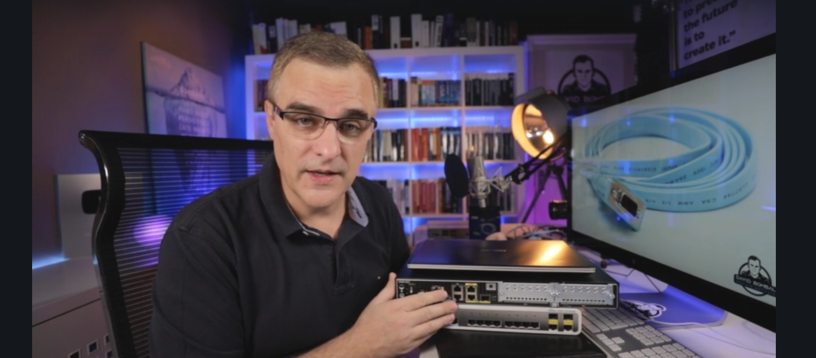
Initial Device Configurations

Slide 12
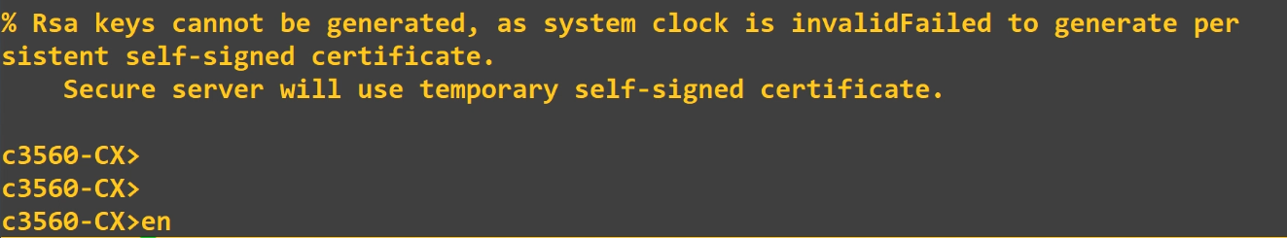
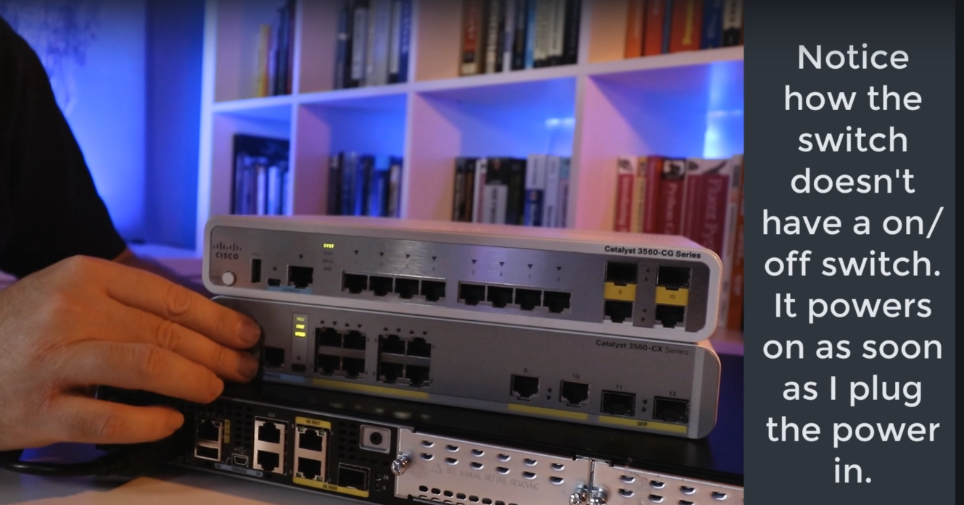
Initial Device Configuration - SWITCHES
Putty – Terminal Emulation Tool
Connection Type - Serial
Out of Band Connection – SSH , TELNET etc.
Check Your Serial Port Number – Device man.
# erase Startup-config
# Show version
# Config Terminal
# Wr
# ? - help

Slide 13
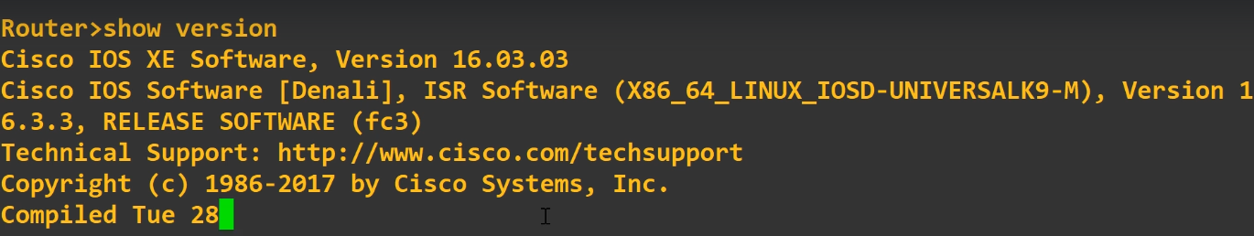
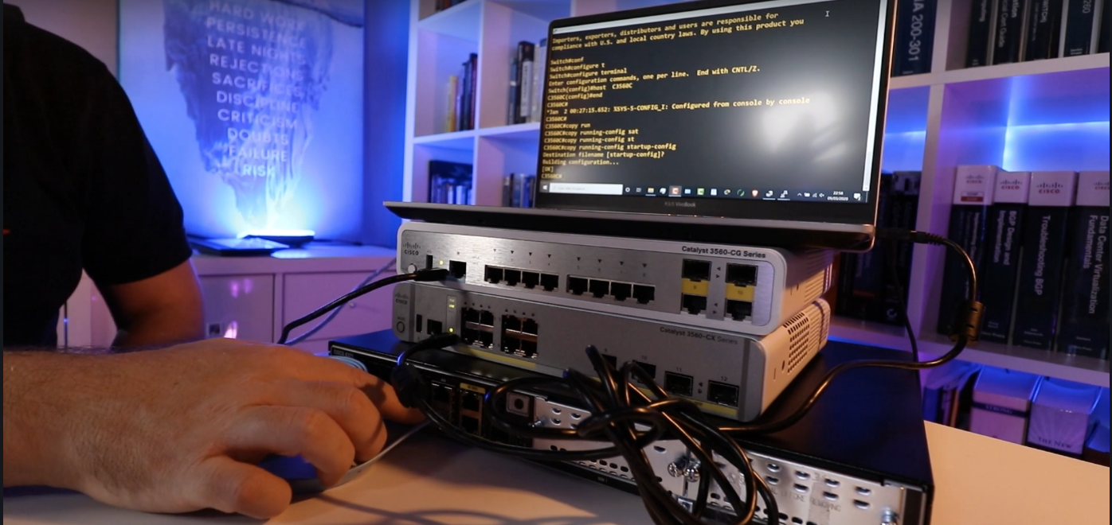
Initial Device Configuration - RouTERS
Putty – Terminal Emulation Tool
Connection Type - Serial
Out of Band Connection – SSH , TELNET etc.
Check Your Serial Port Number – Device man.
# erase Startup-config
# Show version
# Config Terminal
# Wr
# ? - help

Slide 14
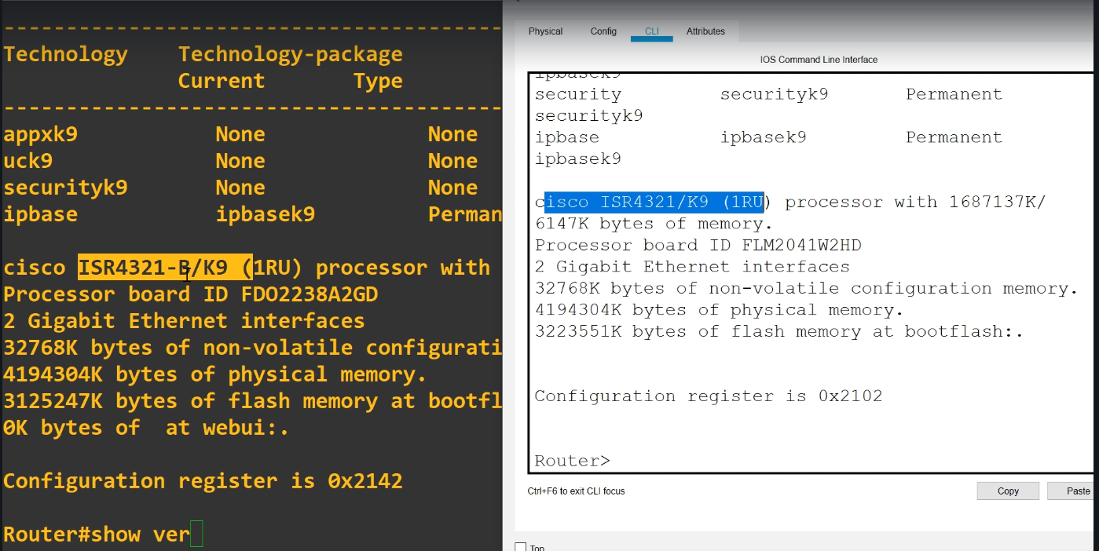
ORIGINAL TERMINAL VS PACKET TRACER

Slide 15
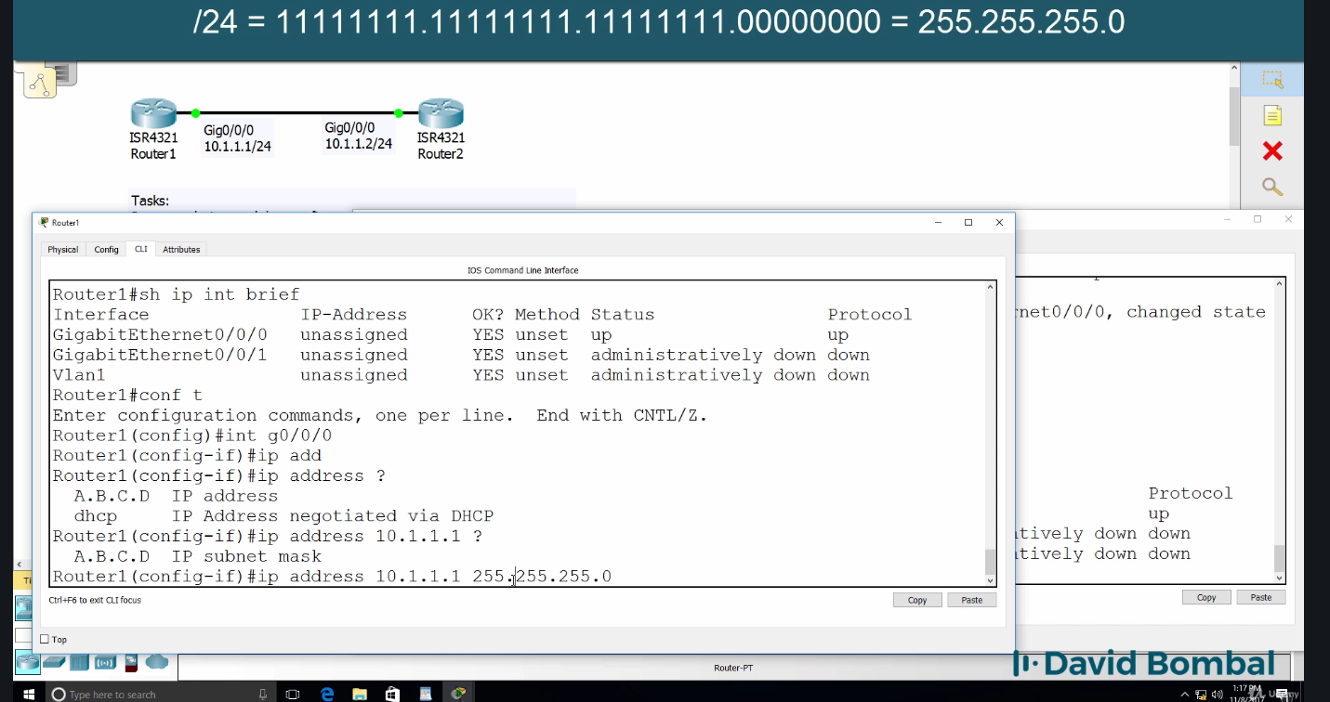
ALLOCATING AND SUBNETTING IP ADDRESS

Slide 16
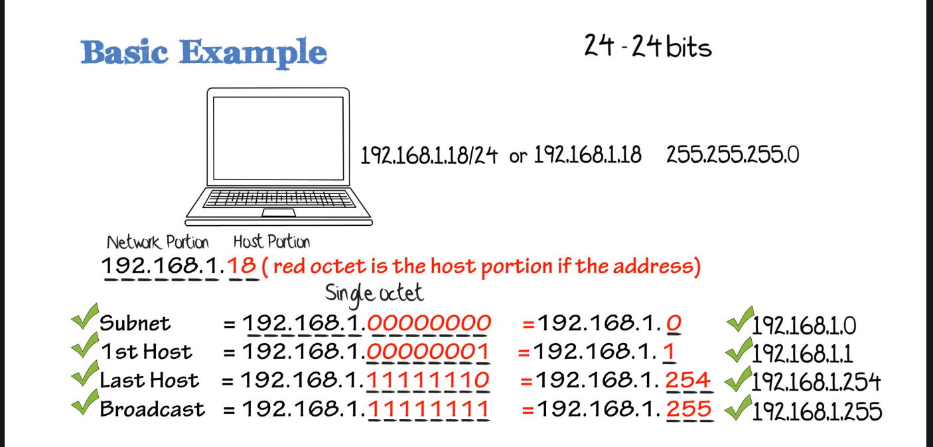
IP SUBNETTING

Slide 17
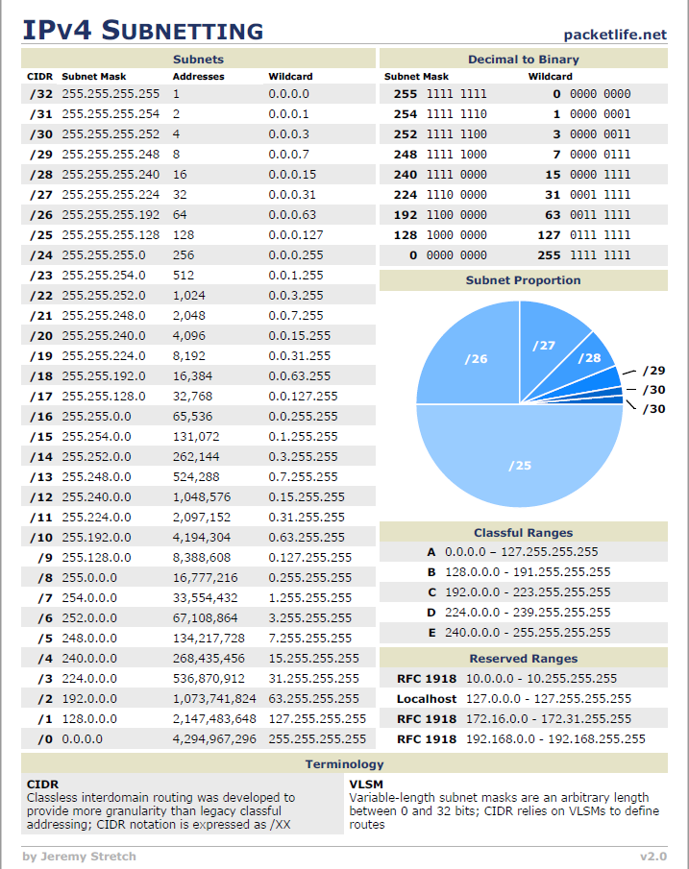
IP SUBNETTING - CHEATSHEET

Slide 18
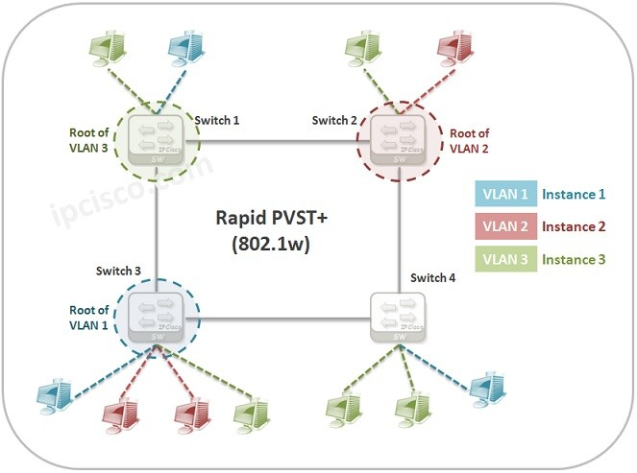
SPANNING TREE
Switches and Routers uses spanning tree to identify and see what, how many devices are connected directly and directly.
STP/802.1D used by earlier cisco devices
PVST + Cisco Improved STP adding a per VLAN feature
RSTP / 802.1W Improved STP – Faster Convergence
Rapid PVST + Cisco improvement of RSTP and used Nowadays
BPDU – Bridge Protocol Data Unit are parts of STPs that transmit messages across LAN to detect loops in Network Topologies.

Slide 19
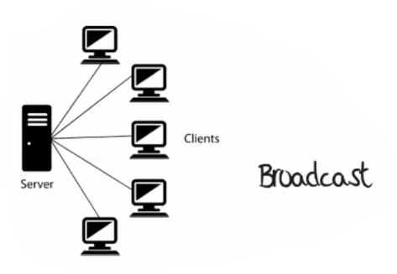
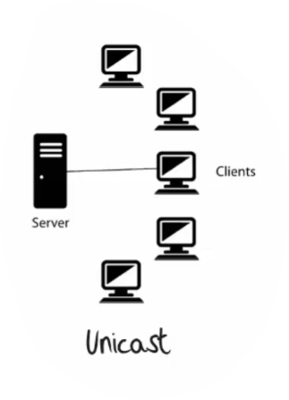
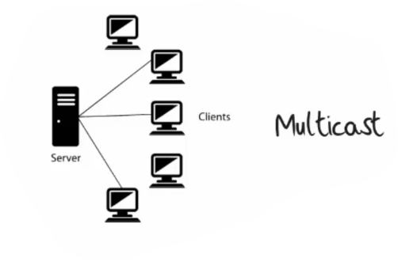
CABLING and PaCKET FLOWS
TYPES OF COMMUNICATION
UNICAST
MULTICAST
BROADCAST

Slide 20
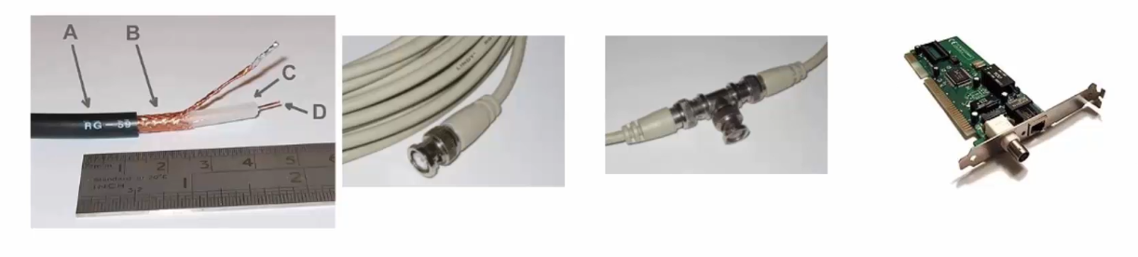
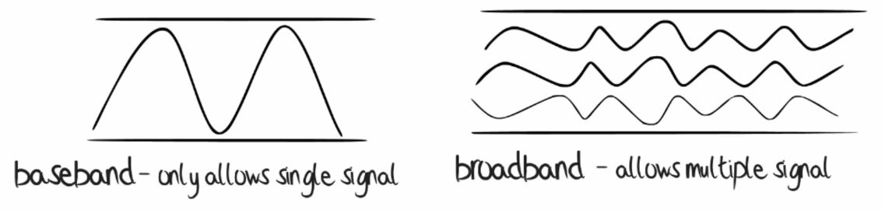
ETHERNET
1970’s Robert Metcoff
10 base 5 – Thicknet(500 meters)
10 base 2 – Thinnet(185 meters)
Base means baseband

Slide 21
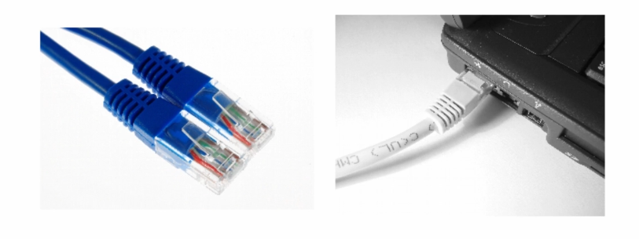
ETHERNET
10 base T
T – Twisted Pair
10 Mbps
Maximum Segment is 100m
UTP and STP

Slide 22
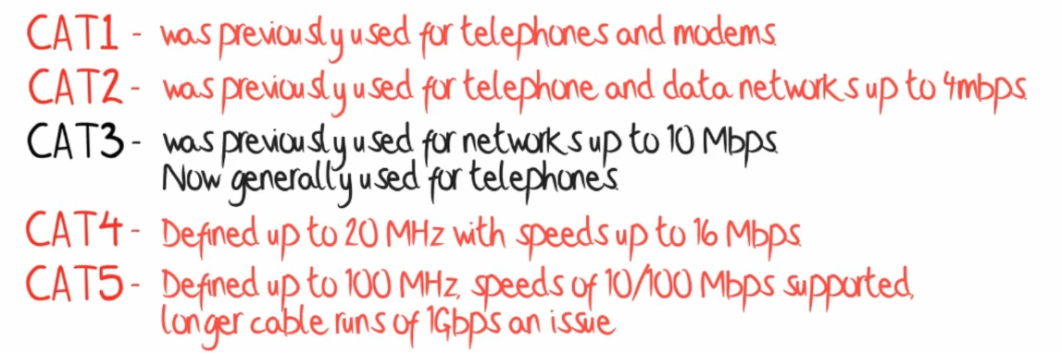
ETHERNET
More Twists
Less susceptible to EMI
More Stringent
Less crosstalk and system noise
Higher supported frequency and Speeds

Slide 23
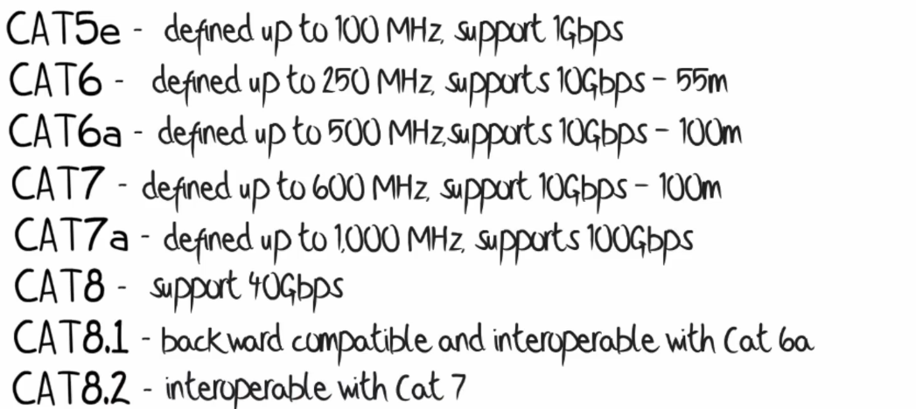
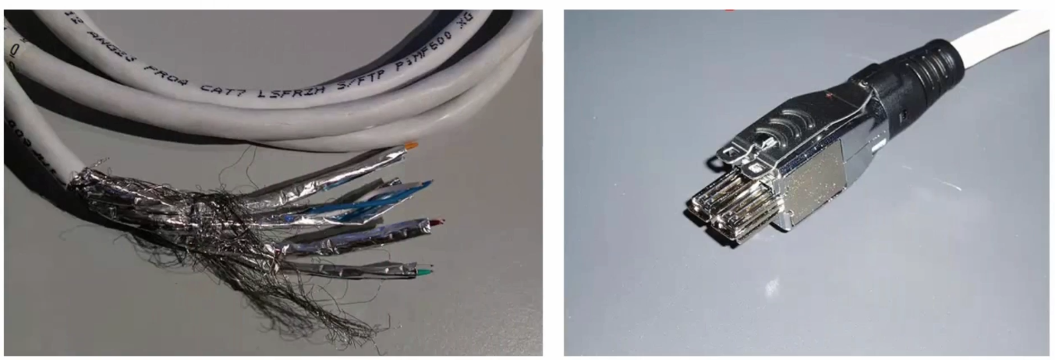
ETHERNET

Slide 24
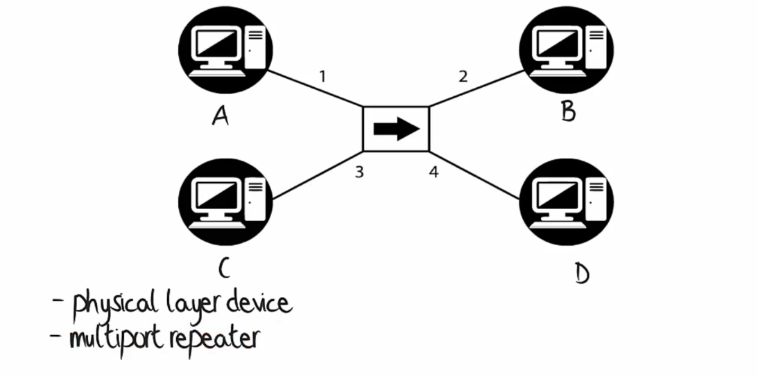
HUBS

Slide 25
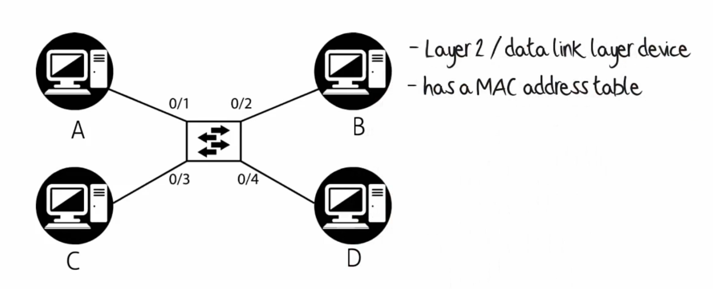
SWITCHES
USES ASICs(Application Specific Integrated Circuits)
No degradation of performance between two devices
Can move traffic at wire speed

Slide 26
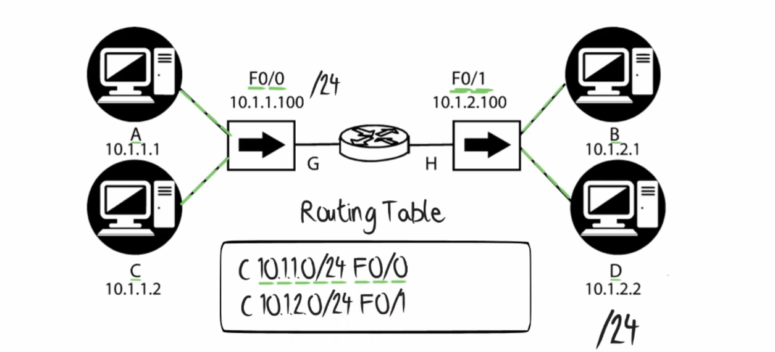
ROUTER

Slide 27
LIFE OF A PACKET
Encapsulation – Process of adding headers and trailers to data
APPLICATION LAYER
HTTP/FTP DATA
PDU
Server
TRANSPORT LAYER
TCP DATA
SEGMENT
HUBS
INTERNET LAYER
IP TCP DATA
PACKET
NETWORK ACCESS LAYER
HEADER MAC IP TCP DATA TRAILER
FRAME

Slide 28
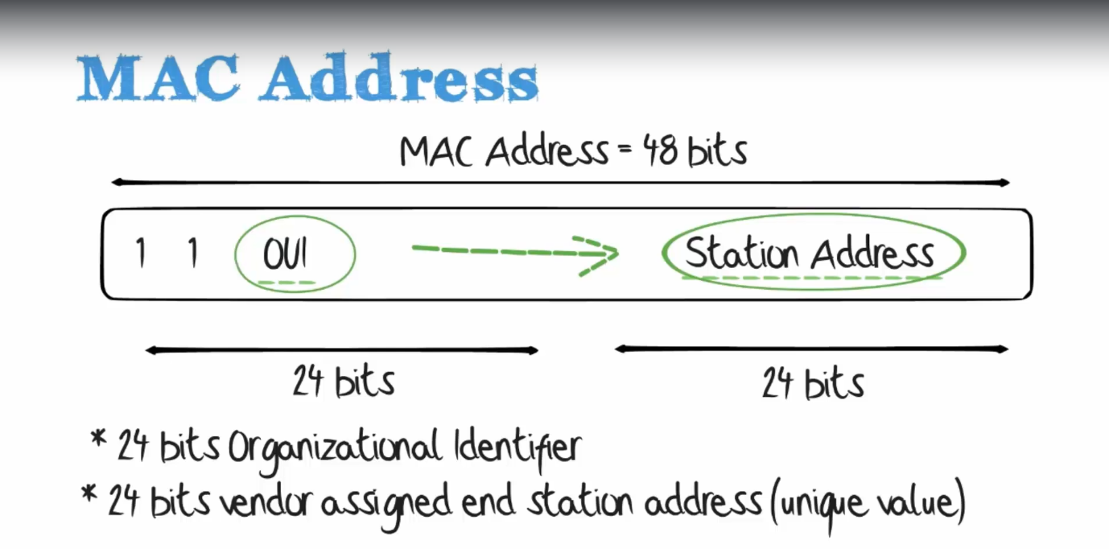
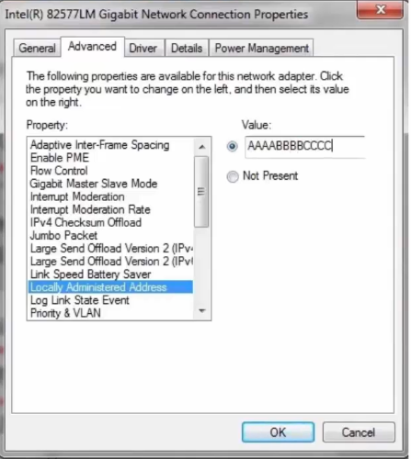
MEDIA ACCESS CONTROL

Slide 29
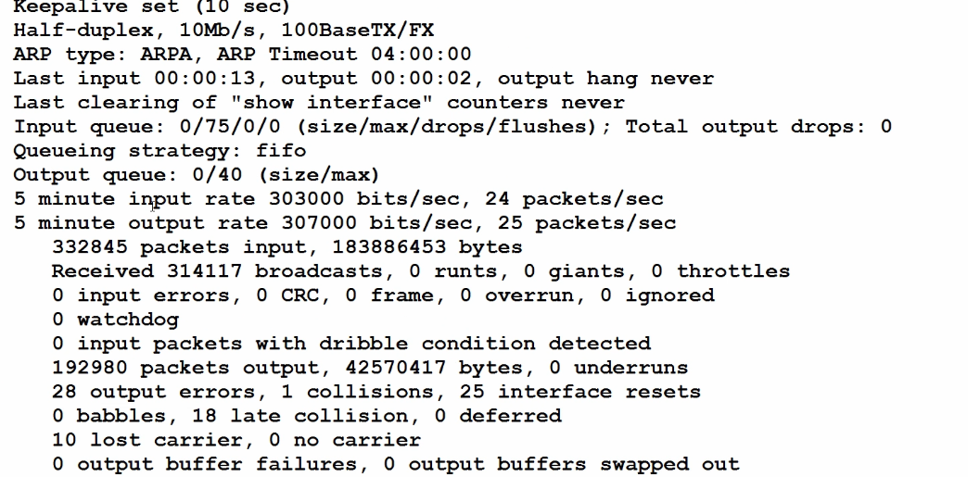
DUPLEX AND SPEED MISMATCH
SPEED MISMATCHES AND DUPLEX MISMATCHES
-when auto negotiation fails
-when manual configuration mismatched
DUPLEX MISMATCHES
-Performance Issue
-Ping may succeed
-Movement of large files will get affected
IN PACKET TRACER
-go to enable mode then type
#sh run int f0/3 {Your interface name}

Slide 30
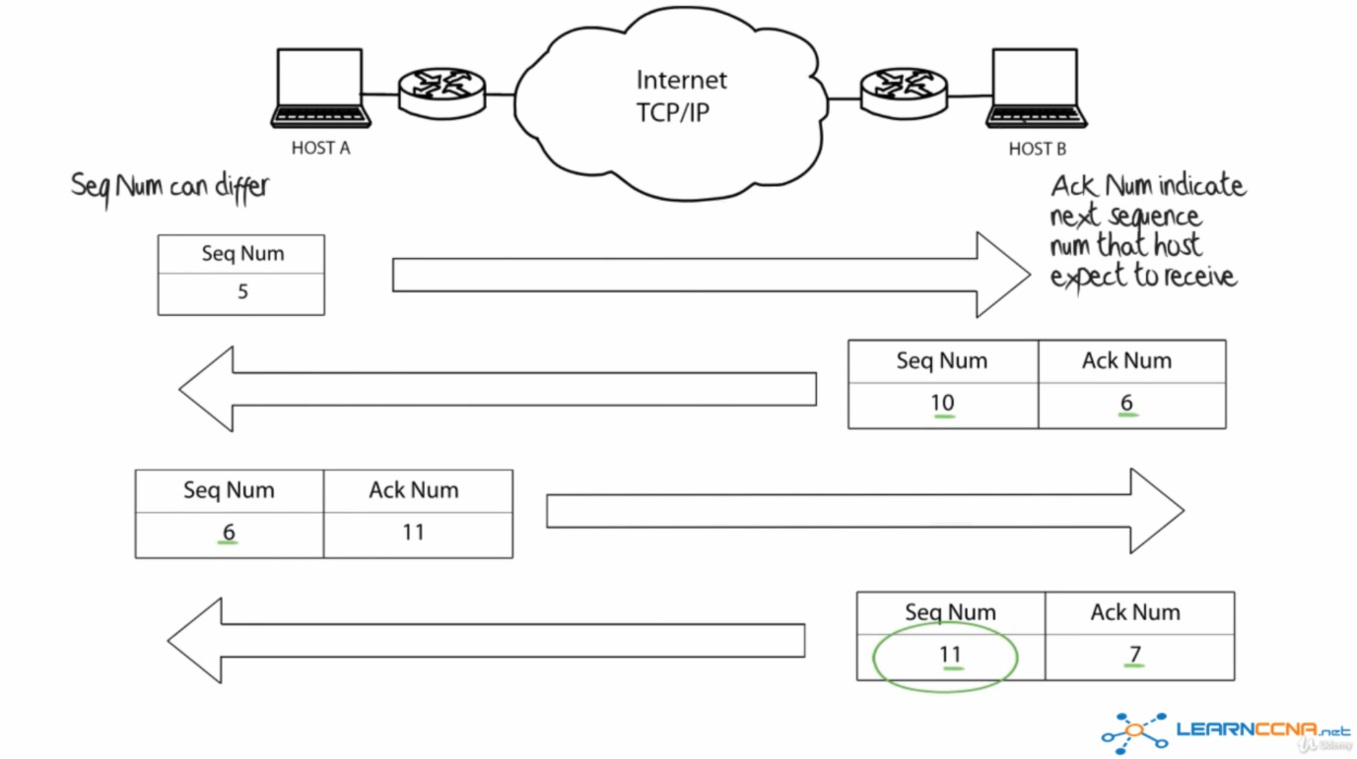
TCP HANDSHAKE

Slide 31
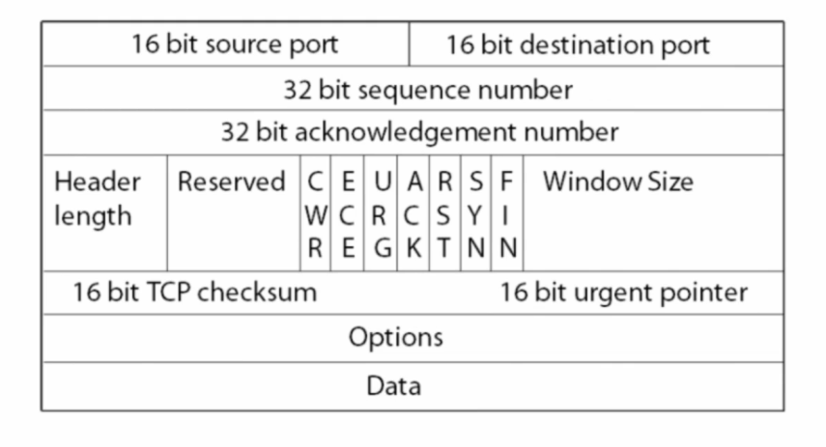
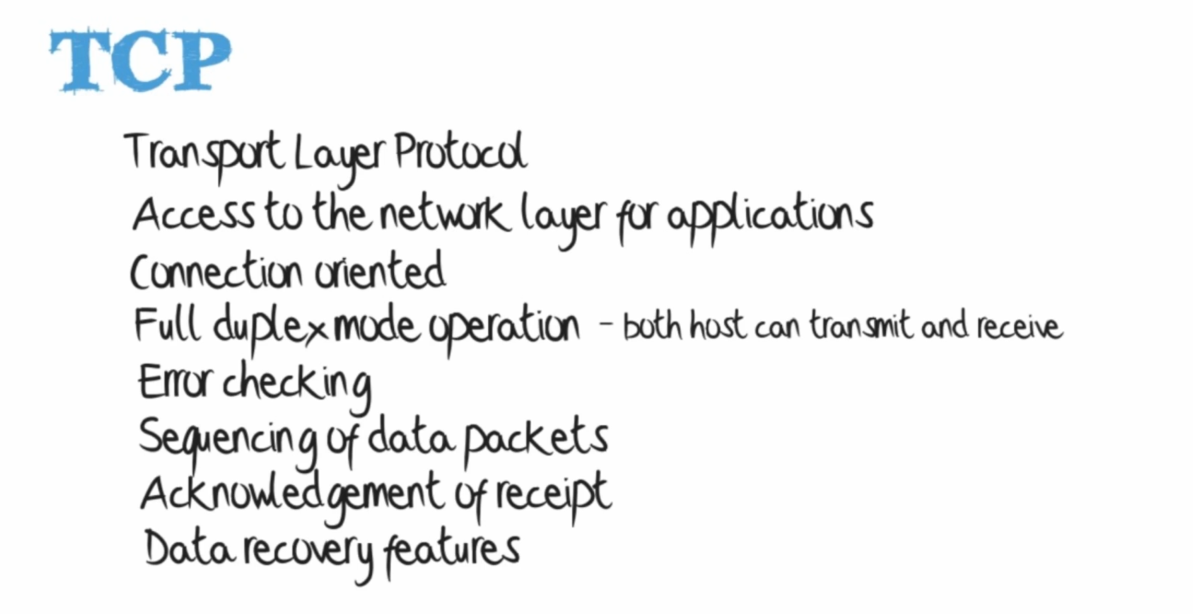
TCP HEADER

Slide 32
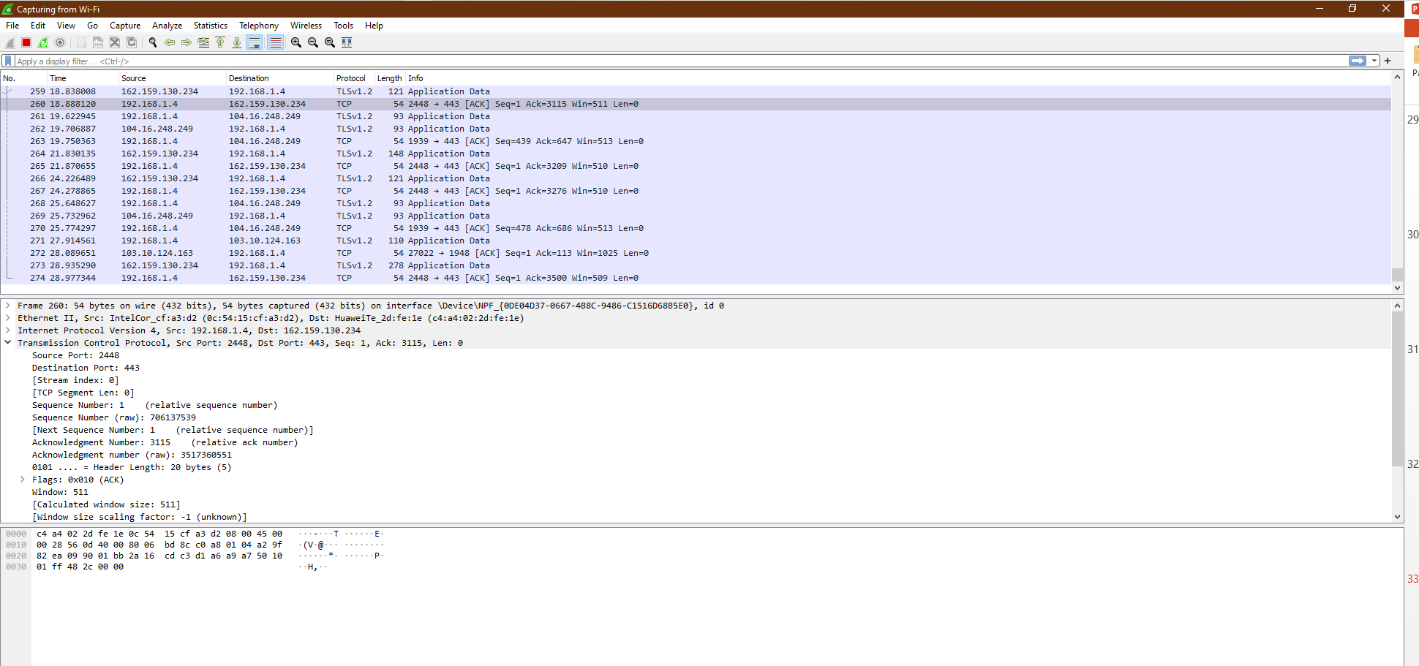
WIRESHARK

Slide 33
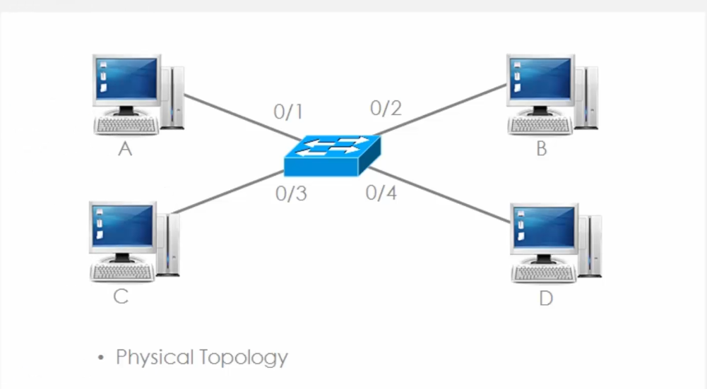
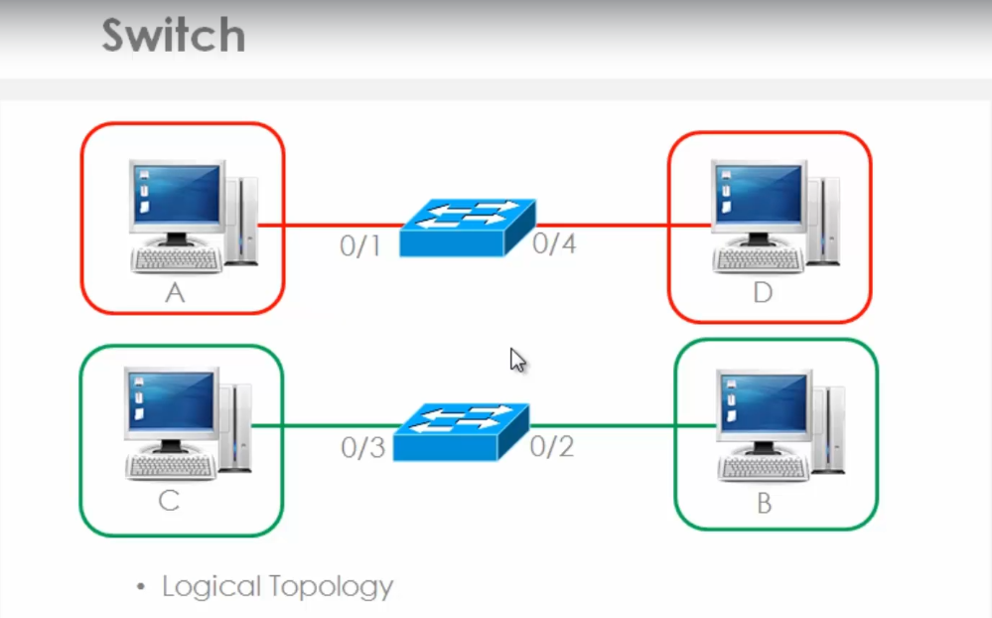
VLAN
VIRTUAL LOCAL AREA CONCEPT IN NETWORKING
-It’s a group of host with common subnet even if they
are not physically connected with same switch
-have single broadcast domain
-so possible to span subnet across multiple switches
-we can segment them in proper category in an company
-increases flexibility
-security
Protocols Used in VLANs
- CDP – Cisco Discovery Protocol
- VTP – Vlan trunking Protocol
-PAGP – Port aggregation Protocol
TYPES
- Static Vlans – Administrative Manually does the entries
-Dynamic Vlans – Sets Vlans category according to mac- address of that system
-Voice Vlan – Set for IP Phones for better management

Slide 34
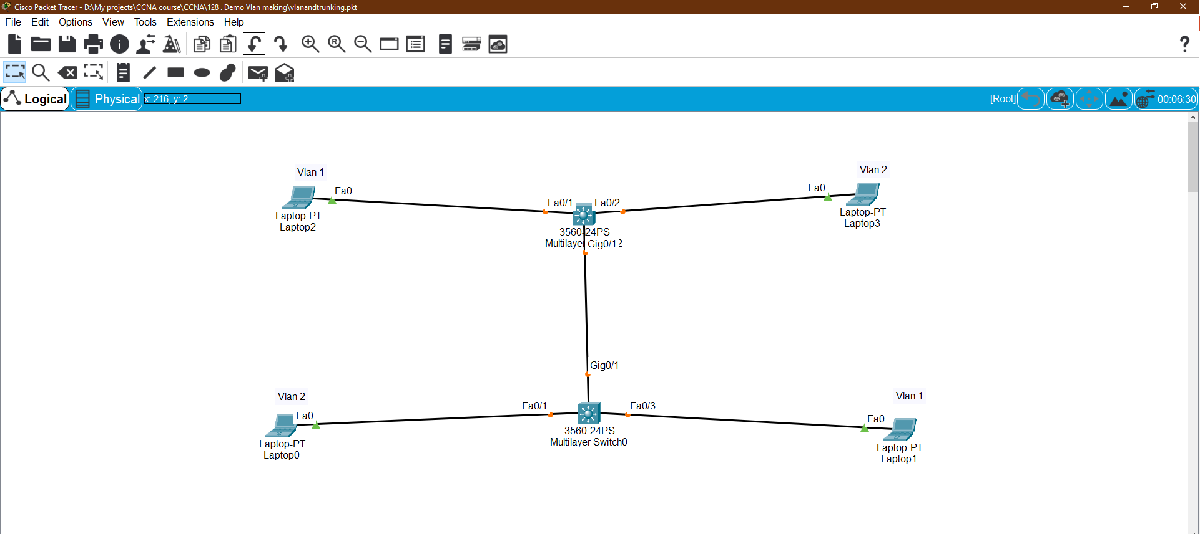
VLAN – PACKET TRACER

Slide 35

Thank You

